Slide 1

Case Analysis of Novel Corona Virus COVID 19
Priya Payyadi Surendran
ID:1533656

Slide 2
Topics Discussed
1
Problem and Requirement Analysis
2
Data Discovery
3
Data Collection and Validation
4
Data Pre-processing
5
Data Summarization

Slide 3
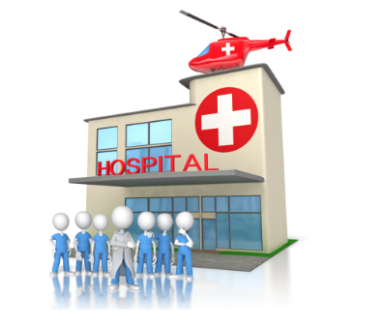
Problem and Requirement Analysis

Slide 4
1. Application Background of the proposed data mining
Topic chosen is the analysis of the cases of COVID-19 in New Zealand from 26th February 2020 to 1st August 2020 which can be applied to medical analysis to get a better insight on how to manage health crisis of this virus outbreak.
How the virus spread pattern is.
Health care providers, organizations, government can anticipate the resources and facilities to manage and tackle the situation.

Slide 5
2. Stakeholders of the research
People
Health care Organization
Hospitals
Scientists and researchers
Government(Federal, state & Local)
Employers
Financial Institutions(Banks and Insurance company)

Slide 6
3. Data mining analytics tasks
Numeric Prediction: Daily cases reported (confirmed or probable). This can be used to compare and arrive at the conclusions like probability of COVID-19 being completely eradicated or probability of increases in cases reported.
Association: Between age, sex and cases being reported. This can be used to analyse whether special preventive measures among males and females of various age group can be taken or if already taken will help them to recover or fight against the virus.

Slide 7

Data Discovery

Slide 8
1. Operational Procedures
Proper identification of a problem or an opportunity that can be analysed (COVID-19 case analysis of New Zealand)
Find in detail the association of the problem or what exactly should be analysed and why exactly it is happening (study the pattern of the virus COVID-19 in different age group and sex)
What data to be collected, how to be collected and from where to be collected(data from Ministry of Health New Zealand from the start of the outbreak of the virus on 26th February 2020 till 1st August 2020 of different age group and sex)
The data collected and prepared is valid and useful for analysing the problem or opportunity.

Slide 9
2. Data in Demand
Age group of the person infected
Sex of the person infected
Date on which case was reported
Geographical location
Recent travel details
Status of the case
Deceased status
Details of health centre where the person is admitted(resources available or not)
Region wise count of cases per day
Recovery status of the person infected
Recovery modes of the person infected(hospitalised or home remedies)
Lockdown status

Slide 10
3. Data Available
Age group of the person infected
Sex of the person infected
Date on which case was reported
Recent travel details like last country visited, flight number, date of departure and arrival
Status of the case (Confirmed or probable)
Deceased status
Region wise (DHB)count of cases per day

Slide 11
4. Gap between data Available and data in demand
Recovery mode(hospitalized or not, if hospitalised how? etc)
Recovery status
Details of health centre where the person is admitted(resources available or not)

Slide 12

Data Collection & validation

Slide 13
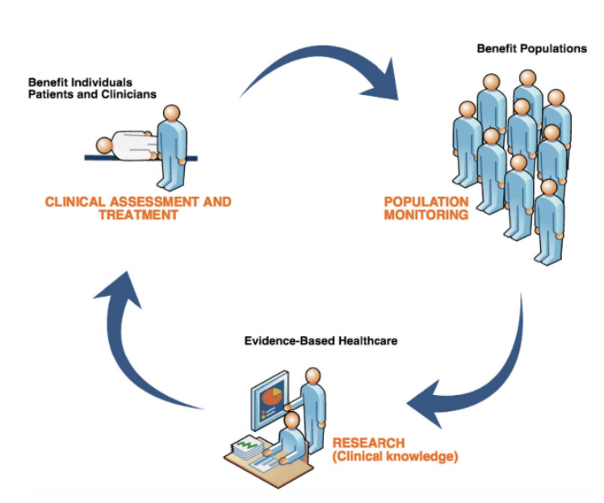
1. Software setup for data validation
The software used is SNOMED CT by the SNOMED International as a part of global effort to manage this pandemic. SNOMED CT is used to record, share, integrate and analyse COVID-19 data.
SNOMED CT can be used to capture COVID-19 related data for data elements like Provider & Facility Details, Patient Demographics, Clinical Assessments, Tests & Investigations, Prevention, Treatment & Education.
There are SNOMED codes for each data element, and these are stored in the patient’s record by health care providers and these are stored by each DHBs in a local database. Later, Ministry of Health collects these data and publishes it for general people after processing it.

Slide 14
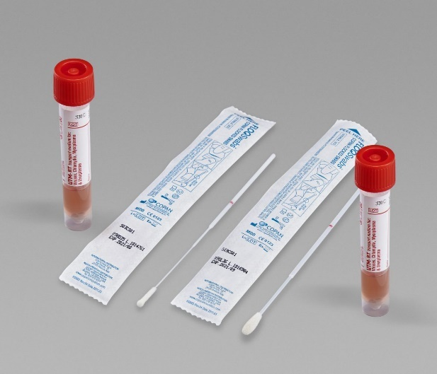
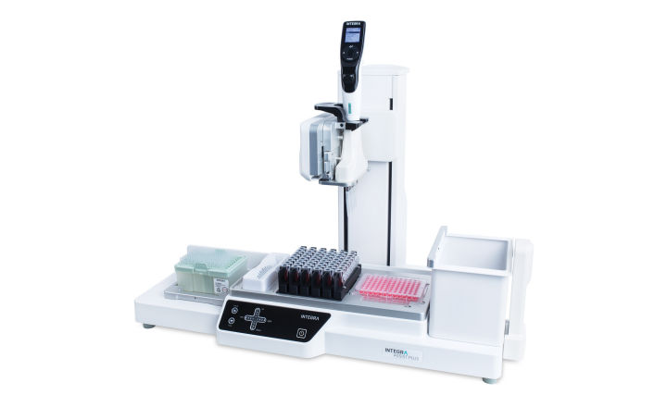
2. Hardware setup for data validation
The hardware used to collect COVID-19 data are swab collection kits and testing equipment of laboratories.
The swabs are mainly collected from upper respiratory parts like nose and throat and are called nasopharyngeal and oropharyngeal swabs.
RT-PCR(Reverse Transcription Polymerase Chain Reaction) technique is used to test these swab samples

Slide 15
3. Requirements for Data Collection
Data collected is related to the research
Data collected must be valid.
The data collected should be the data in demand and there should not be a gap between data in demand and its availability
The data gathered should be useful for the stakeholders
Data collected to analyse the problem or the opportunity under the research must answer all the research questions.

Slide 16
4. Data Validation
Make sure that the gathered data helps the researchers to tackle the problem or opportunity under question.
Data validated will be valid and clean.
Convert the raw data by using data transformation and data pre-processing methods like cleaning, integrate , transform

Slide 17

Data Pre-processing

Slide 18
1. Data Integration from different sources
Attributes must have same name.
Attributes must have same representation (Date format, age group categorization)
Case Status
Probable
Confirmed
Last country before return
United States of America
New Zealand
United Kingdom
United Arab Emirates
Date notified of potential case | Sex | Age group
26/02/2020 | Female | 60 to 69
2/03/2020 | Female | 30 to 39
4/03/2020 | Male | 40 to 49
5/03/2020 | Male | 70+

Slide 19
2. Data Cleaning
Real world data are dirty, noisy, inconsistent and incomplete
Missing values: ignored, using a constant like “unknown” to fill in or impute the missing values using attribute mean or decision tree
Noisy data: Clustering, detecting the suspicious values by a combined inspection by human and computer or smoothening it out by fitting the data in to regression functions.

Slide 20
2. Data Cleaning
My dataset contained many missing values : attributes like ”Overseas Travel”, ”Last country before return”, ”Flight number”, ”Flight Departure date” and “Arrival Date” .
I replaced the missing values with the constant value “unknown” which seems to be more apt for the research.
The attribute “Last country before return” to New Zealand has 943 missing values and I used the filter “ReplaceMissingValuesWithUserConstant” and substituted it with constant value ”Unknown”.

Slide 21
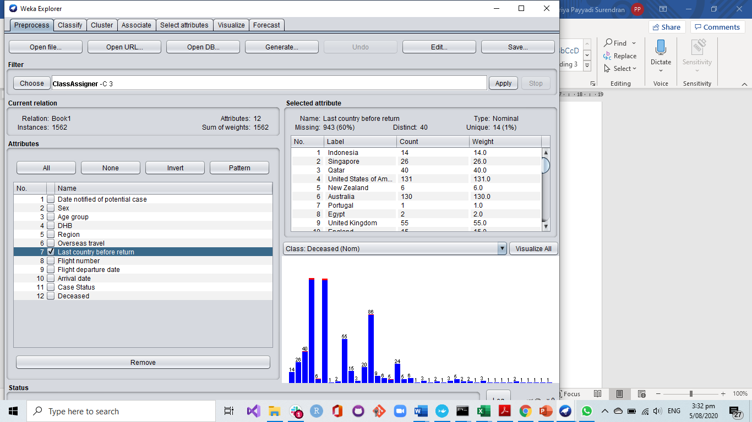
2. Data Cleaning

Slide 22
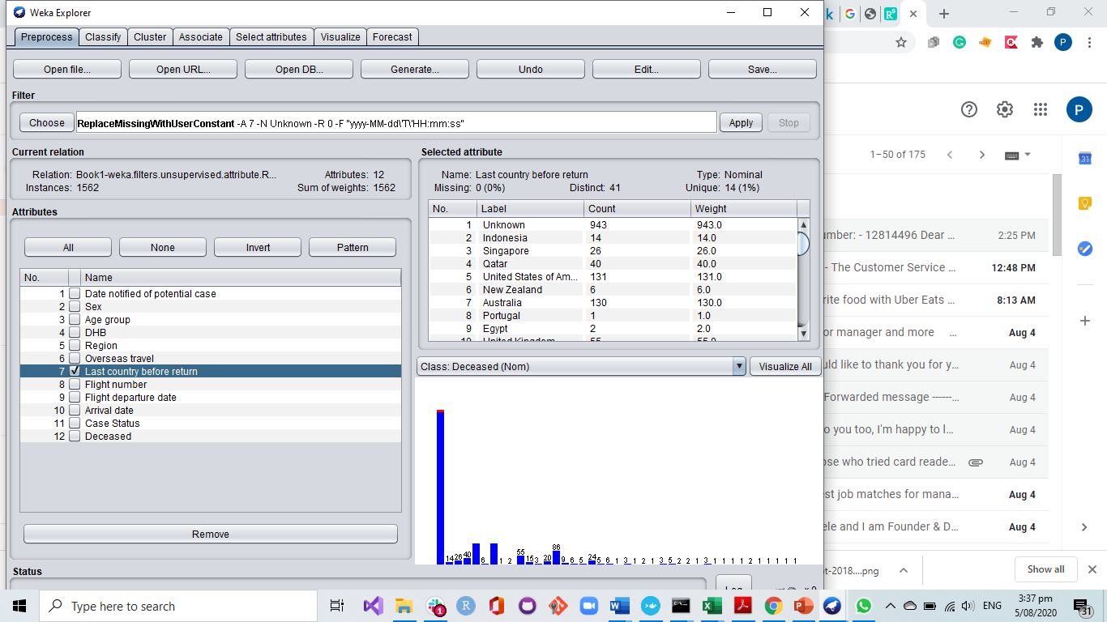
2. Data Cleaning

Slide 23
3. Data Transformation
The final part of data pre-processing is data transformation.
Normalization, Aggregation, Discretisation, Generalisation, Attribute construction, and smoothing are the different data transformation methods .
The attributes in the dataset I collected is pretty much transformed.
The age is already in categorical form and not in numerical form.
The only attribute with most distinct values is DHB and the same can be clustered region wise to get a better understanding . I used generalisation to achieve it.

Slide 24
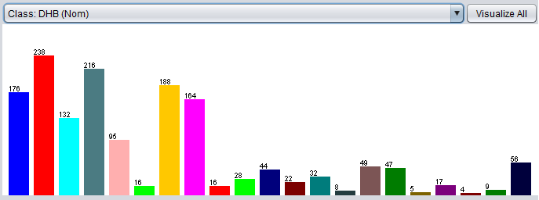
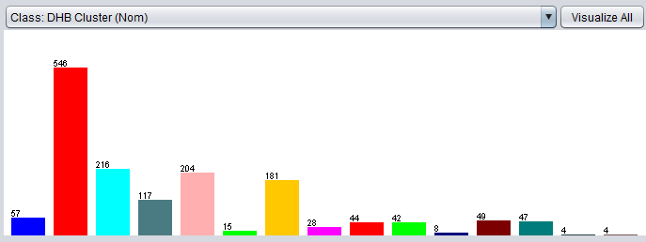
3. Data Transformation

Slide 25

Data Summarization

Slide 26
1. Introduction of Dataset
COVID-19 is a family of viruses that got the name from their spiky crown and the name was designated by World Health Organization on 02/11/2020.
On 11/03/2020, WHO declared it as pandemic and as a part of preventing and controlling the spread, many countries adopted lockdown.
The dataset I chose is the collection of data elements related to COVID-19 of New Zealand from the date of virus infection being first reported i.e. 26/02/2020 to 01/08/2020 till 9am by the Ministry of Health

Slide 27
2. Format and statistical description of dataset
Dataset gathered from health.govt.nz was in excel format. I converted it in to csv format to use it in weka.
1562 instances and 11 attributes
All the attributes are nominal values.
Categories like age, sex, DHB , case status, deceased or not etc
Data arranged from the first date on which COVID-19 was reported in New Zealand till 1st August 2020.

Slide 28
3. Suggestion for future data collection
The data studied was confined to New Zealand alone, may be a larger dataset either globally or continent wise.
The dataset was already tidy and hence could not apply much of the data integration and data pre-processing. So get a more dirtier dataset.
May be as a part of future data collection, a huge data set with more attributes that are in demand integrated from different sources can lead to a better data mining and a better research conclusion.

Slide 29
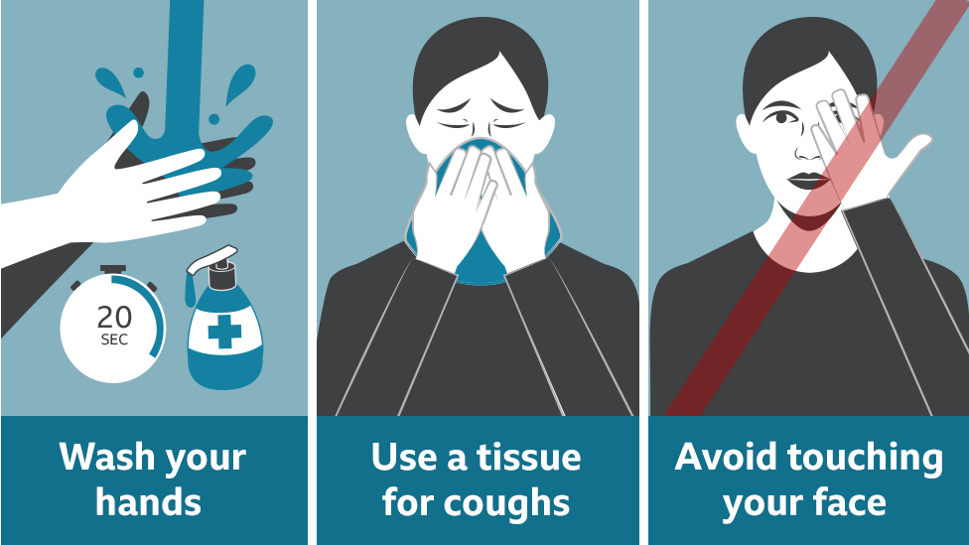
Thank you
Questions????

